Slide 1
API Testing Project

Slide 2
agenda
What is An API?
Why Are we Testing API Requests?
My API Testing Project
Conclusion

Slide 3
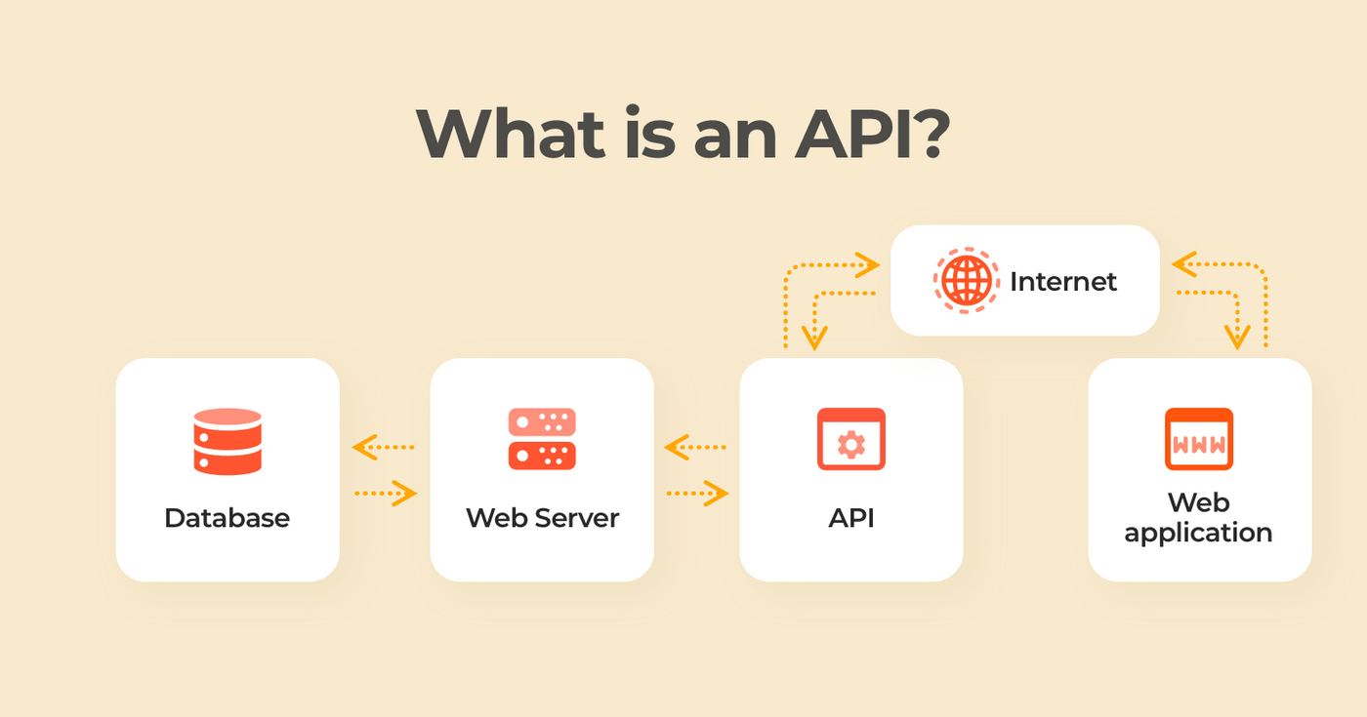
What is An API?
API stands for Application Programming Interface.
APIs are mechanisms that enable two software components to communicate with each other using a set of definitions and protocols.
For example, the weather bureau’s software system (Web Server) contains daily weather data. The weather app on your phone (Application) “talks” to this system via APIs and shows you daily weather updates on your phone.

Slide 4
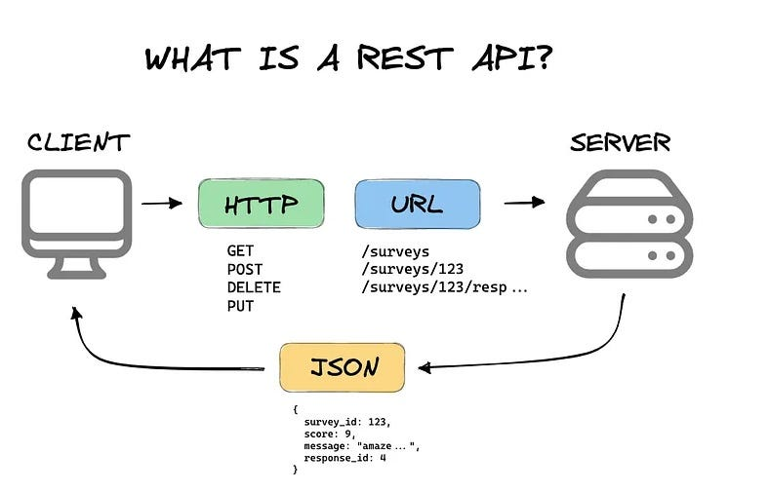
What is Rest API?
REST stands for Representational State Transfer. REST defines a set of functions like GET, PUT, DELETE, etc. that clients can use to access server data. Clients and servers exchange data using HTTP.
The main feature of REST API is statelessness. Statelessness means that servers do not save client data between requests. Client requests to the server are similar to URLs you type in your browser to visit a website. The response from the server is plain data, without the typical graphical rendering of a web page.

Slide 5
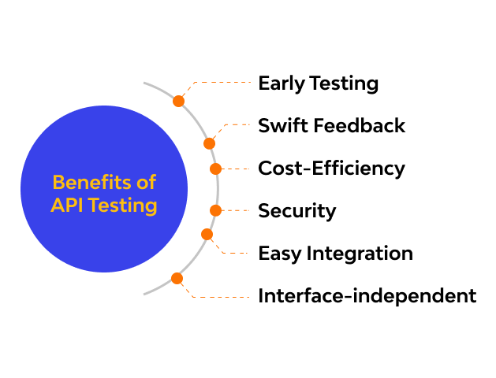
Why are we Testing API?
API testing lets Testers start testing early in the development cycle before the UI is ready. Any request that doesn't produce the appropriate value at the server layer won't be displayed on the UI layer. This lets Testers eliminate at least half of the existing bugs before they become more serious problems.
It also lets testers make requests that might not be possible through the UI -- a necessity for exposing security flaws.

Slide 6
Project Website
https://fakerestapi.azurewebsites.net/
Endpoints
Activities /api/v1/Activities
Authors /api/v1/Authors
Books /api/v1/Books
CoverPhotos /api/v1/Coverphotos
Users /api/v1/Users
Methods for each endpoint
Get
Post
Put
Delete

Slide 7






Tools used
Postman
Restassured
Testng
Allure(for report Generation)
Intellij (Java programming language)

Slide 8
Tests Performed
Tests performed are mainly
Functional Testing
Verification of Response codes
Validation of json files received
Non-Functional Testing (Performance)
Response time
Accessibility

Slide 9
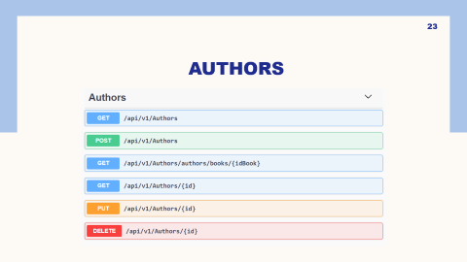

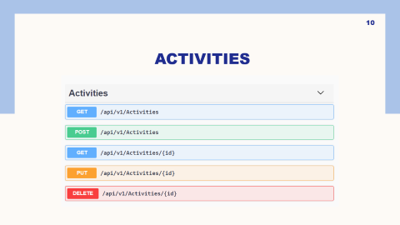
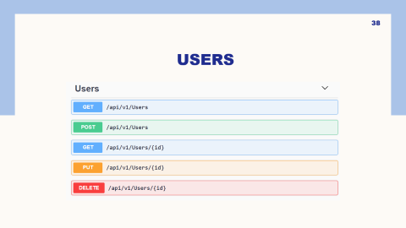
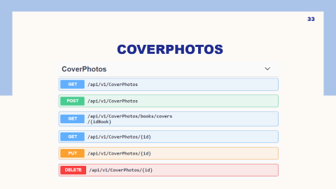
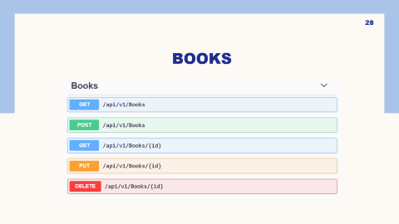
Endpoints

Slide 10
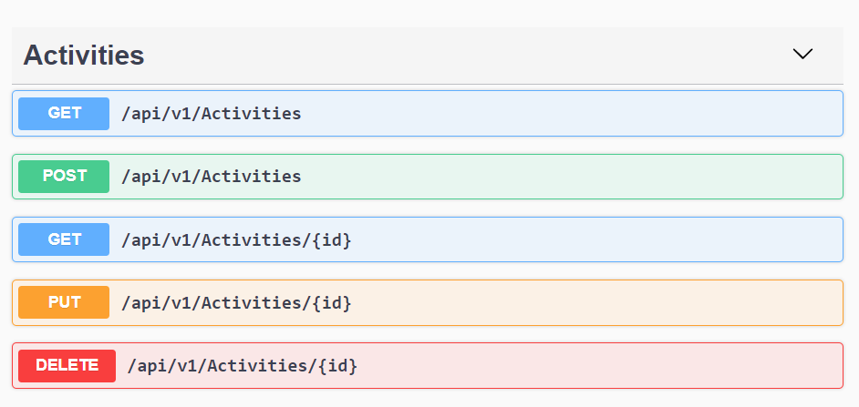
Activities

Slide 11
Test Cases

Slide 12
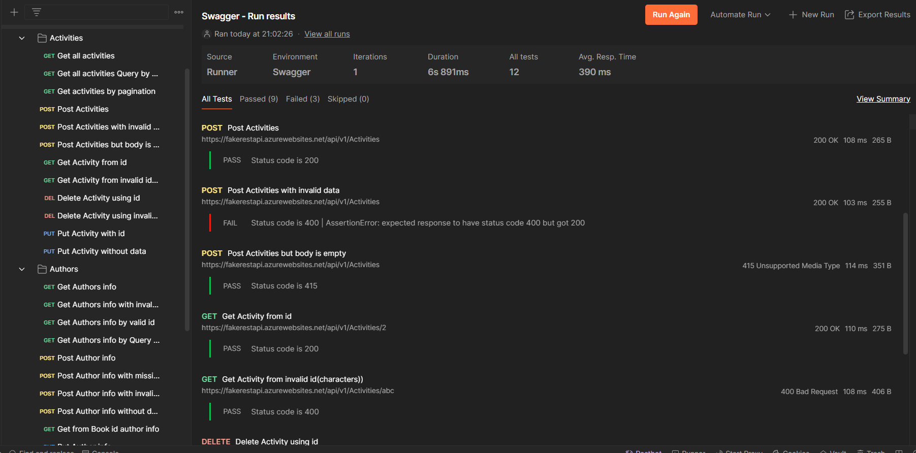
PostMAn Execution

Slide 13
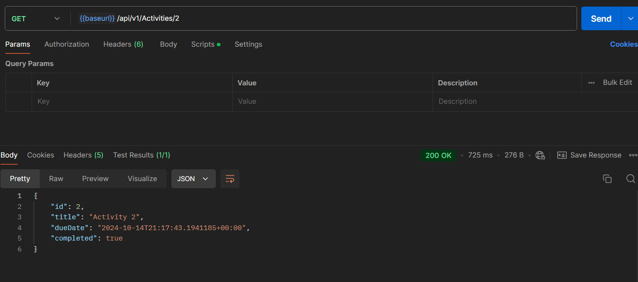
Example of a Valid Testcase(Get)
Request
Response

Slide 14
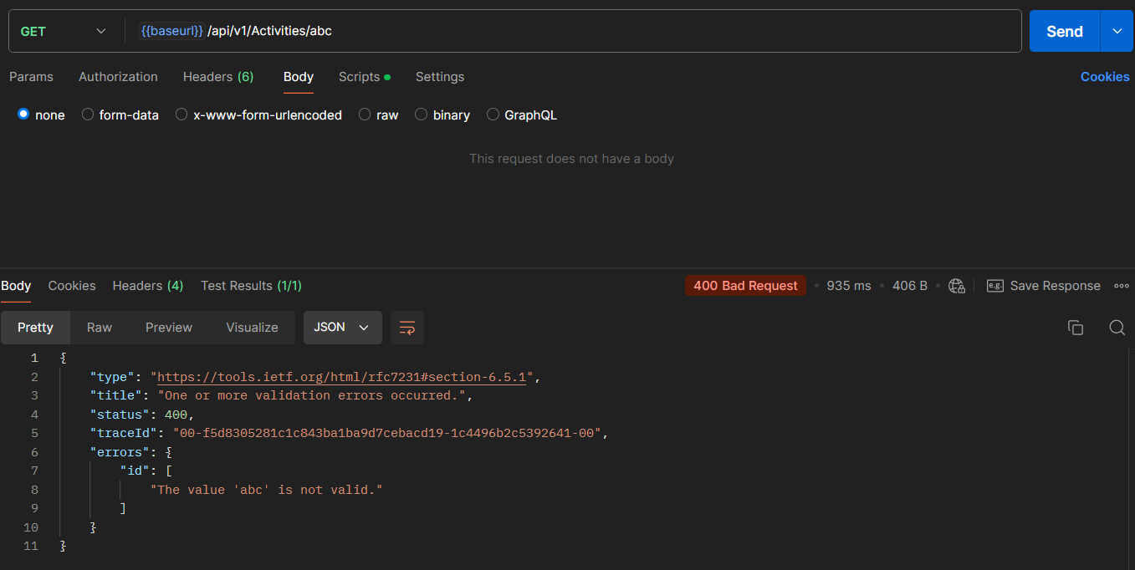
Example of an inValid Testcase(get)
Request
Response
Response

Slide 15
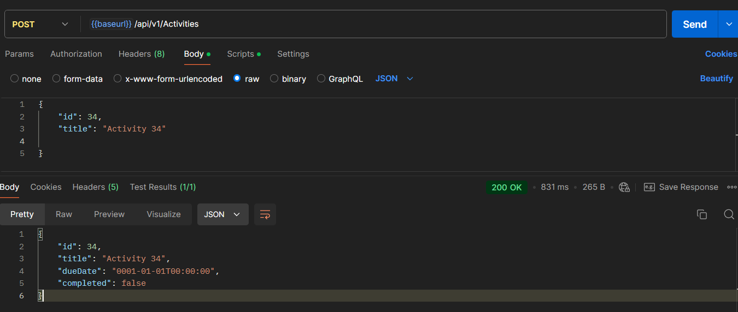
Example of a valid Testcase(Post)
Request
Response
Response
Response

Slide 16
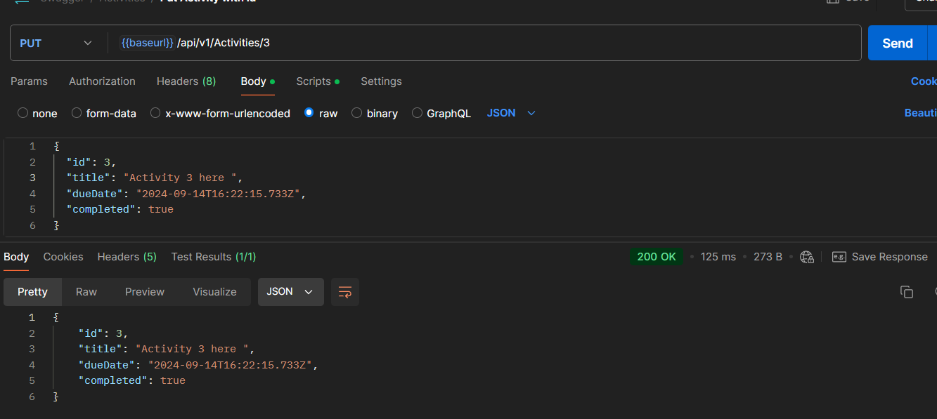
Example of a valid Testcase(Put)
Request
Response
Response
Response
Response

Slide 17
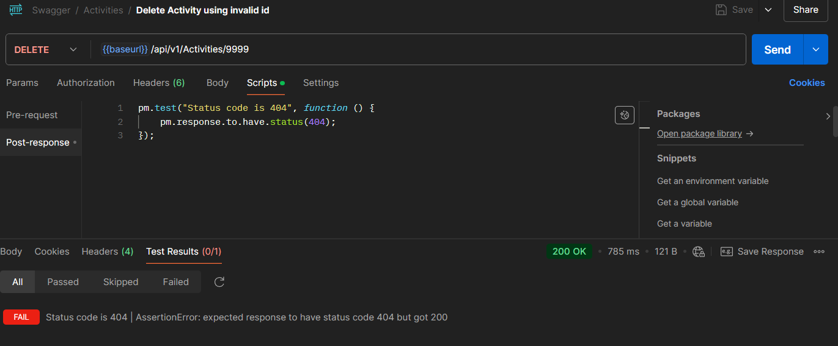
Example of a faild testcase
Request
Response
Response
Response

Slide 18
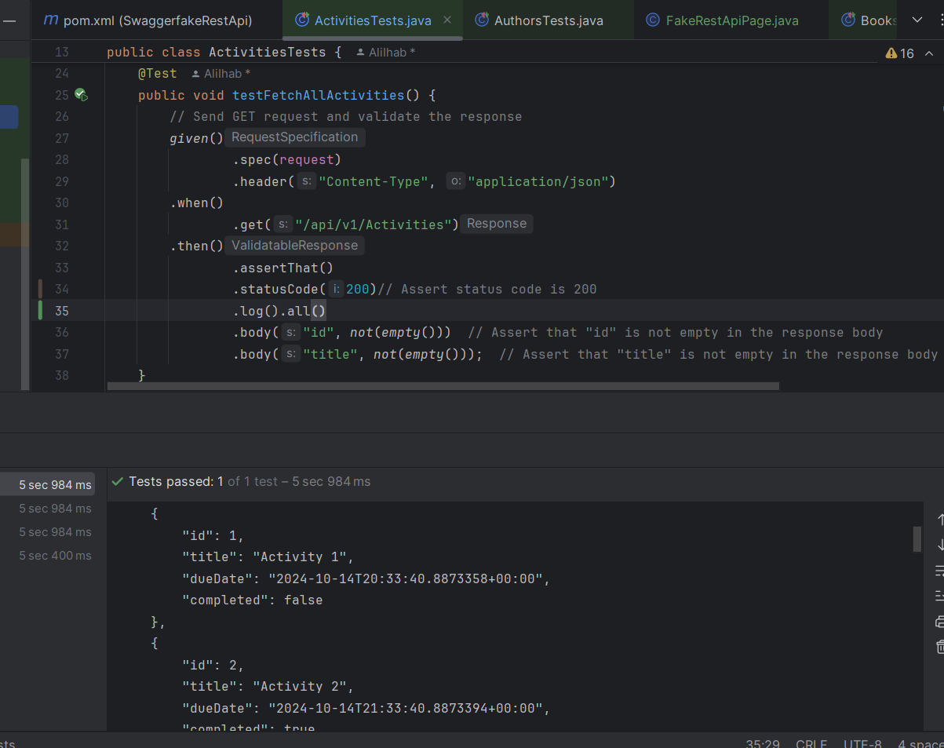
Restassured Valid Testcase example(GET)

Slide 19
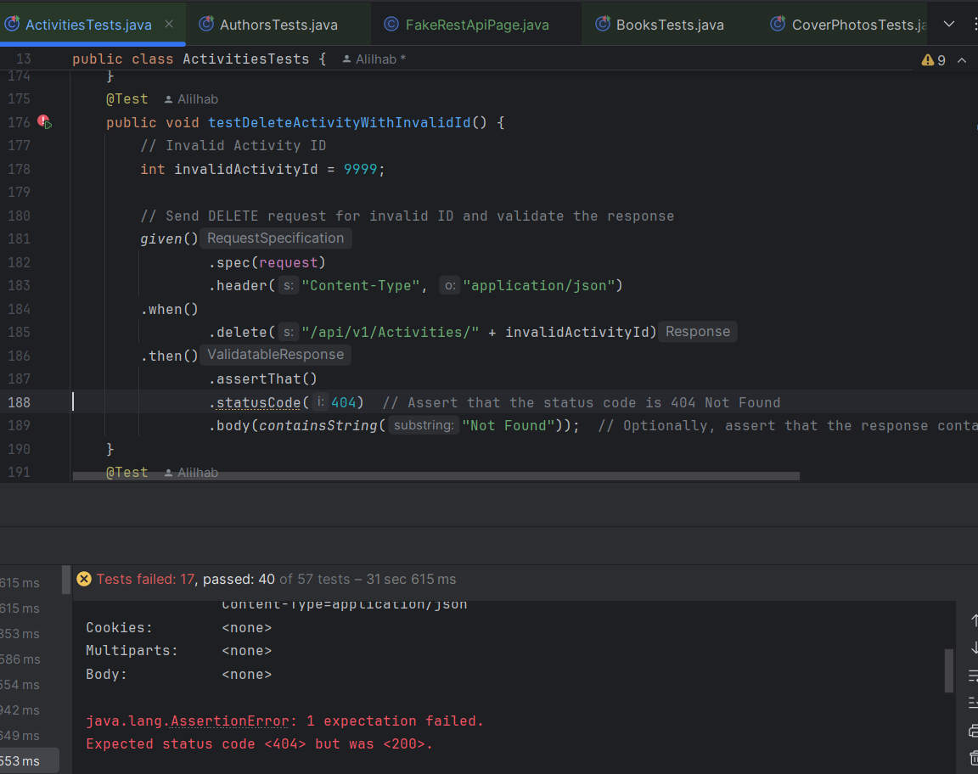
Restassured faild Testcase example(Delete)

Slide 20
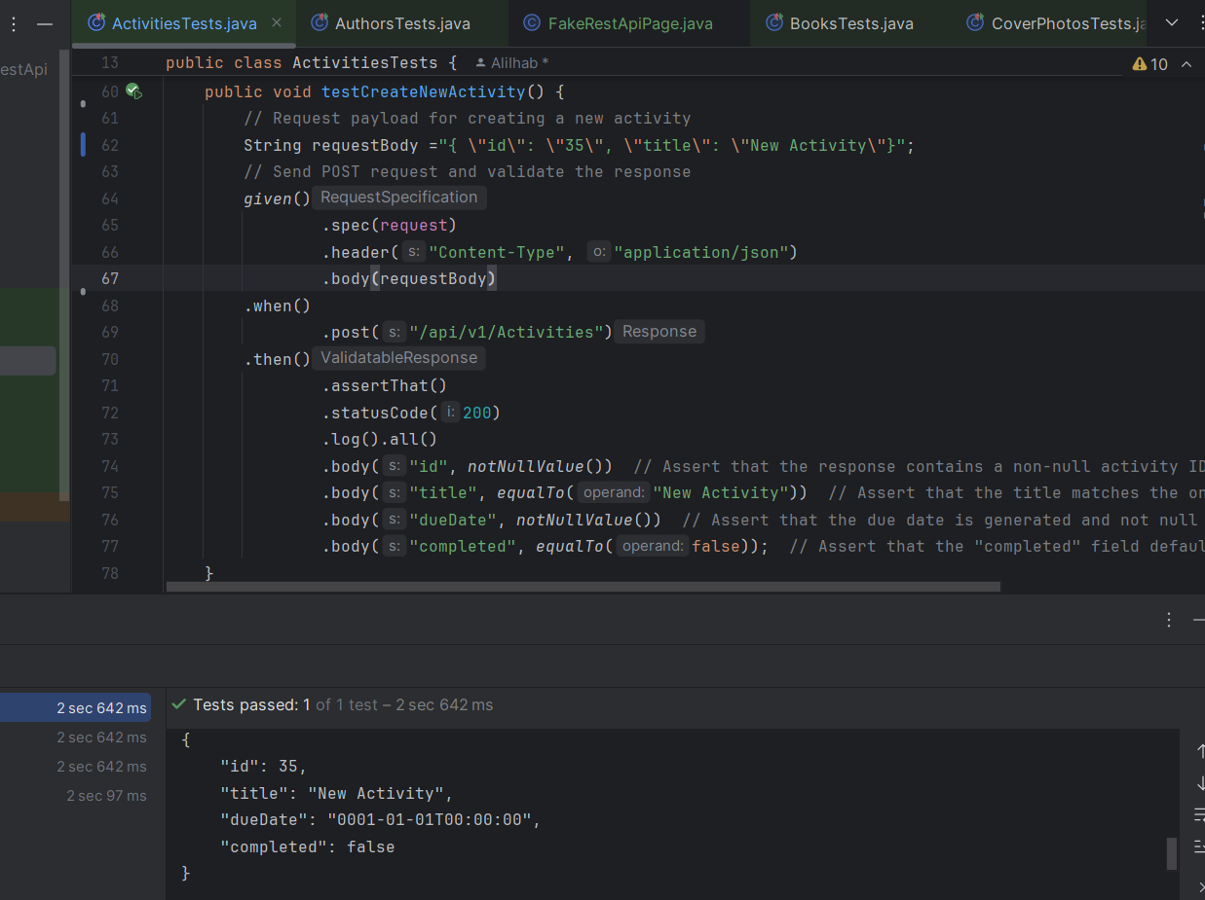
Restassured valid Testcase example(Post)

Slide 21
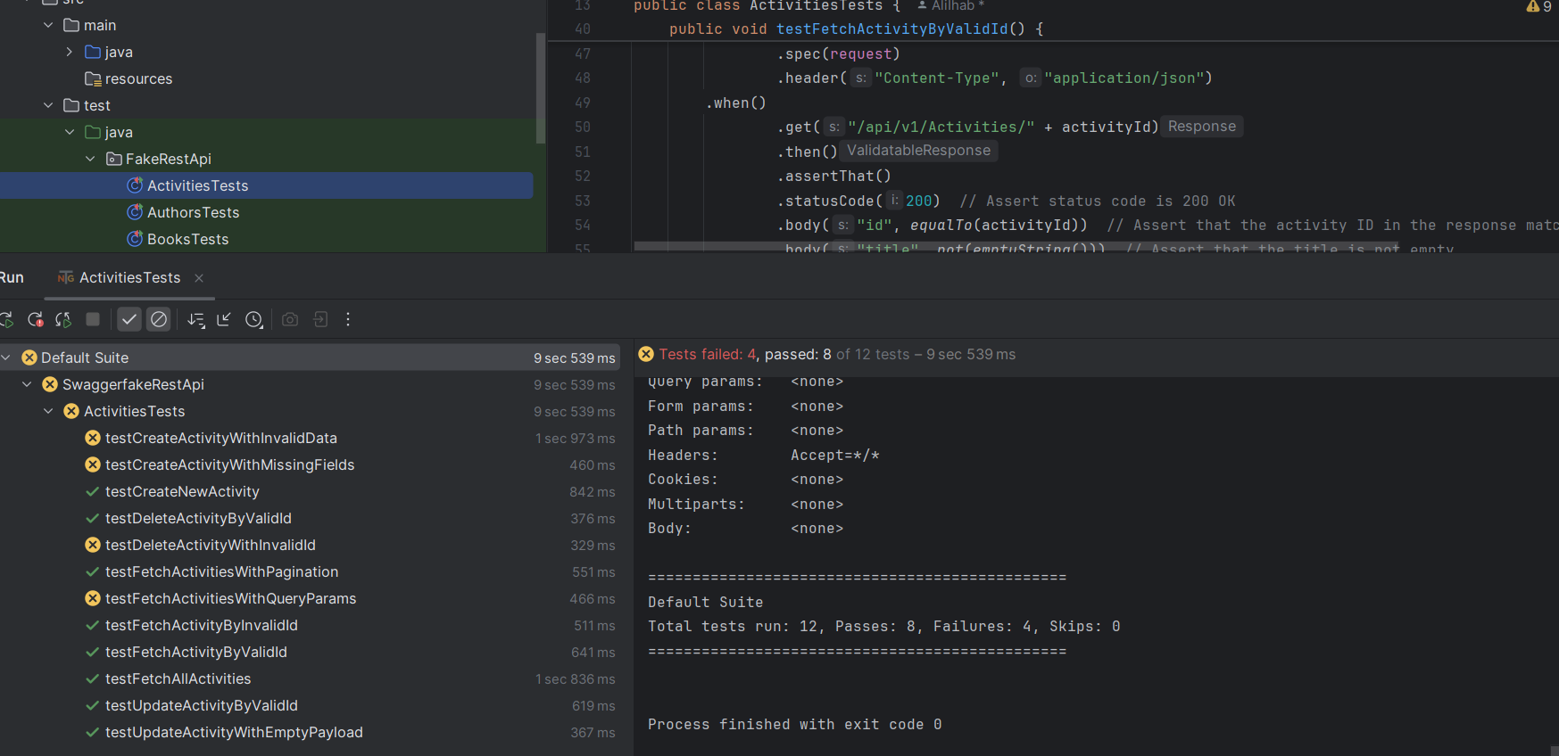
Restassured Testcases executed

Slide 22
Bug Report

Slide 23
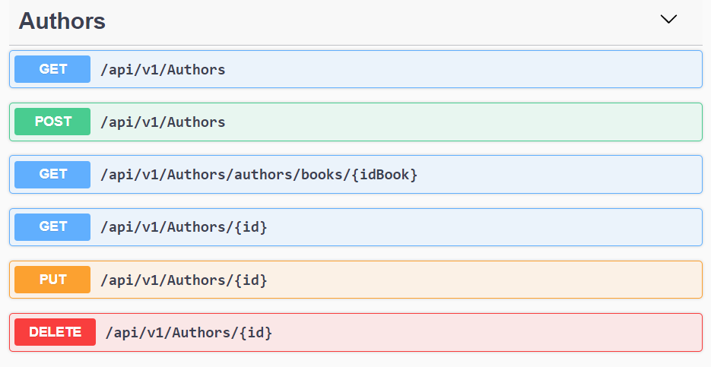
Authors

Slide 24
Test Cases

Slide 25
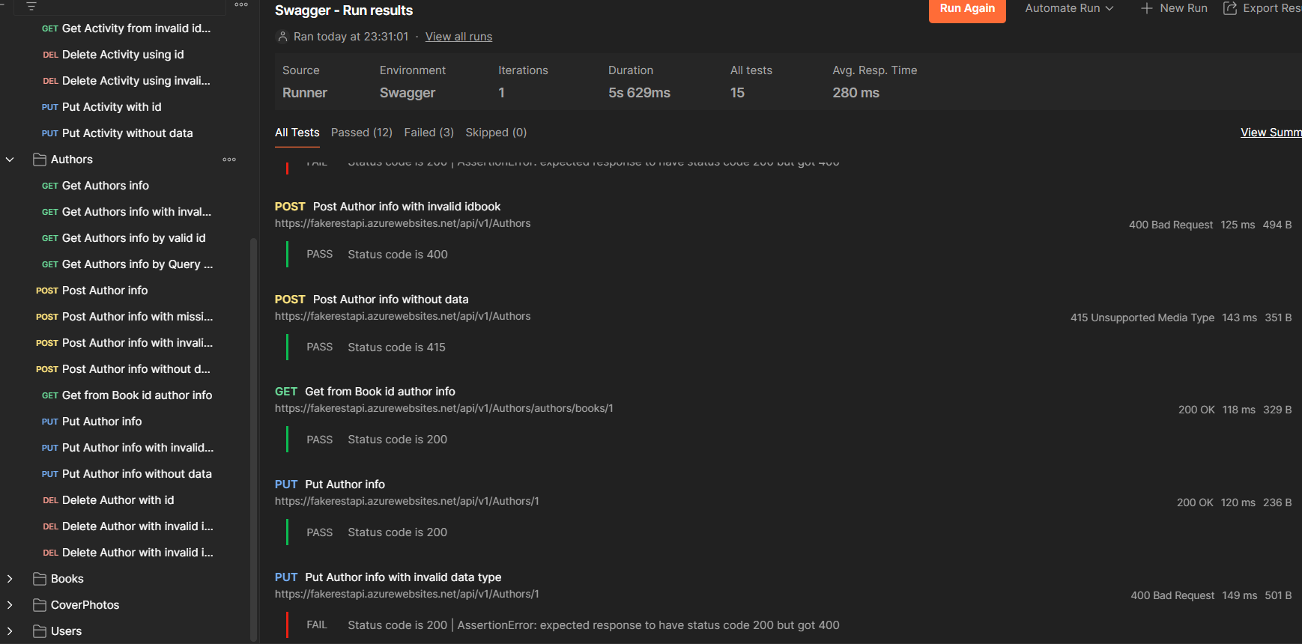
PostMAn Execution

Slide 26
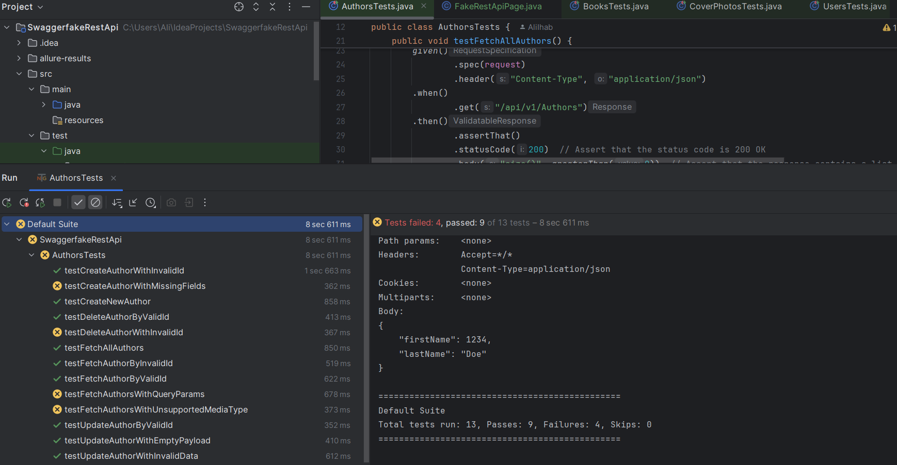
Restassured Testcases executed

Slide 27
Bug Report

Slide 28
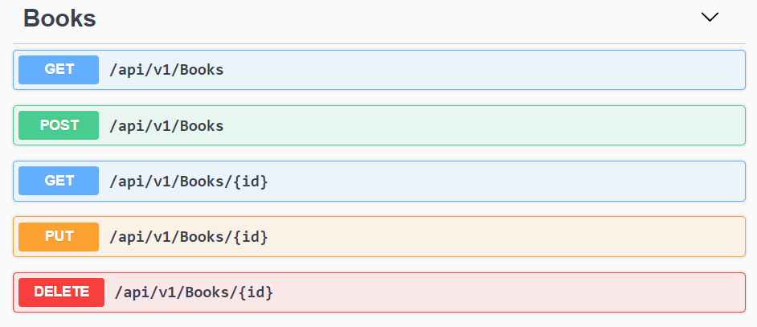
Books

Slide 29
Test Cases

Slide 30
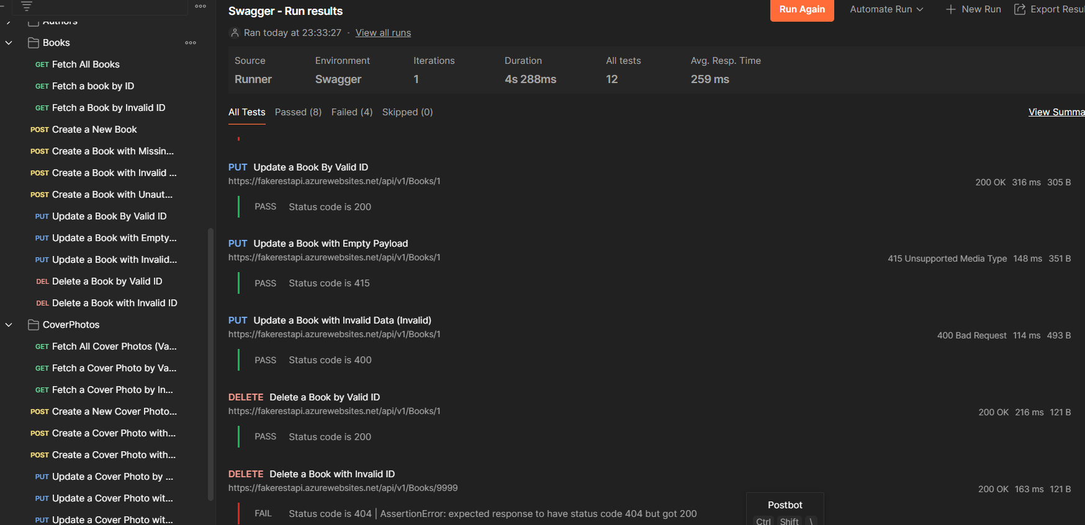
PostMAn Execution

Slide 31
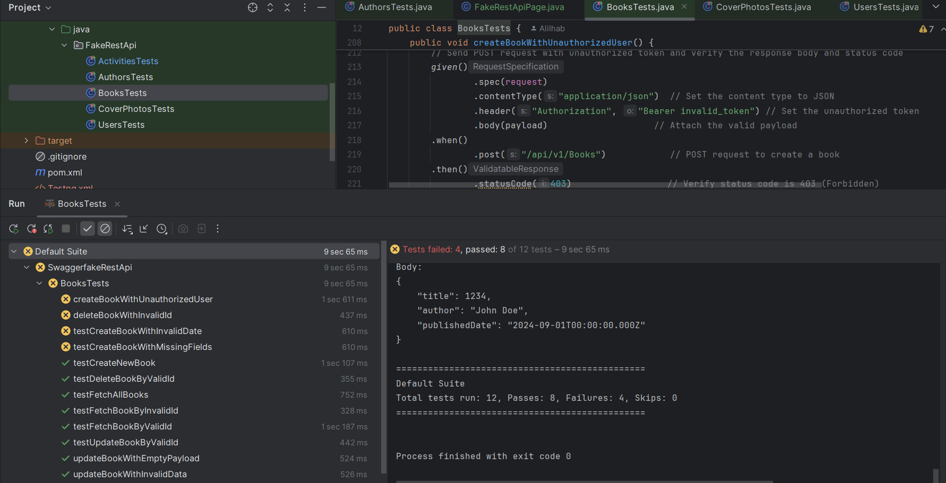
Restassured Testcases executed

Slide 32
Bug Report

Slide 33
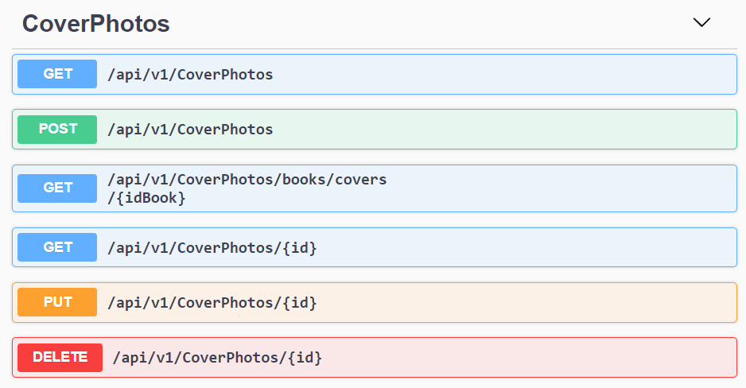
Coverphotos

Slide 34
Test Cases

Slide 35
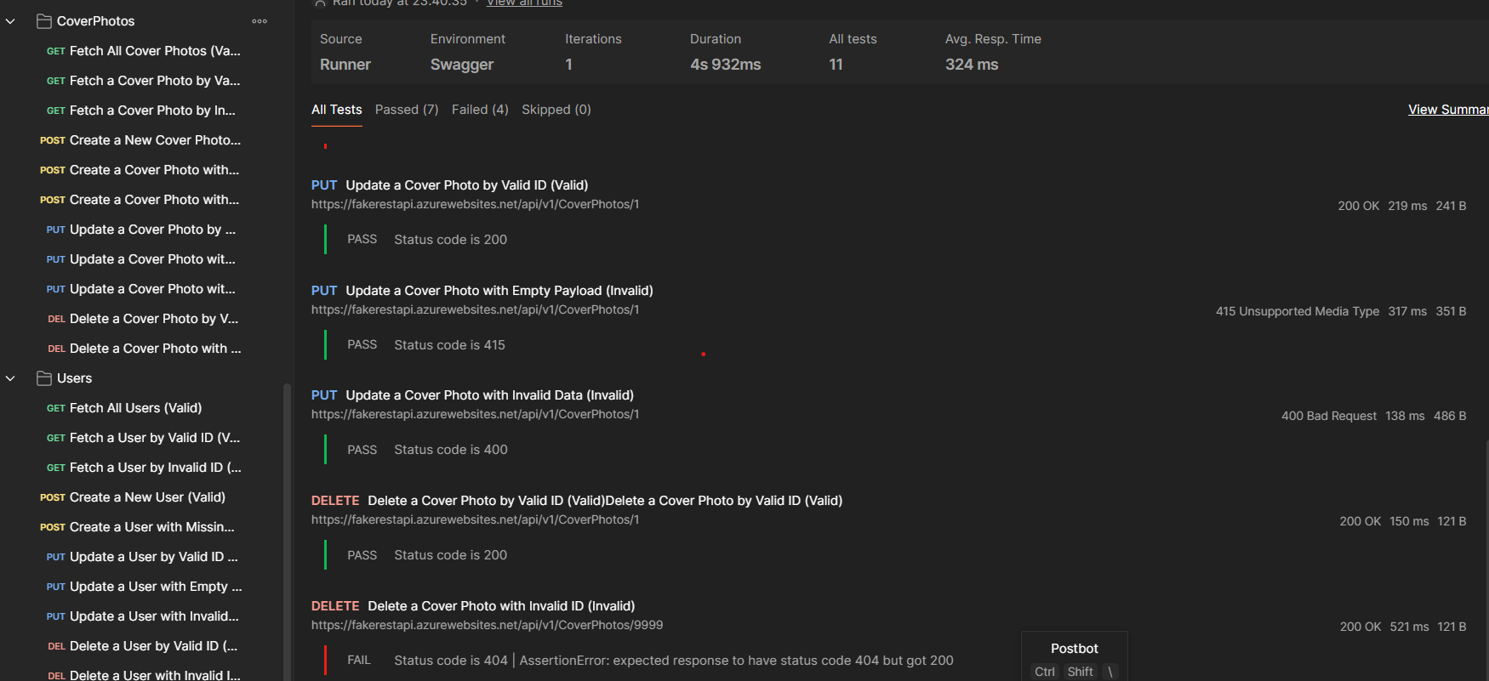
PostMAn Execution

Slide 36
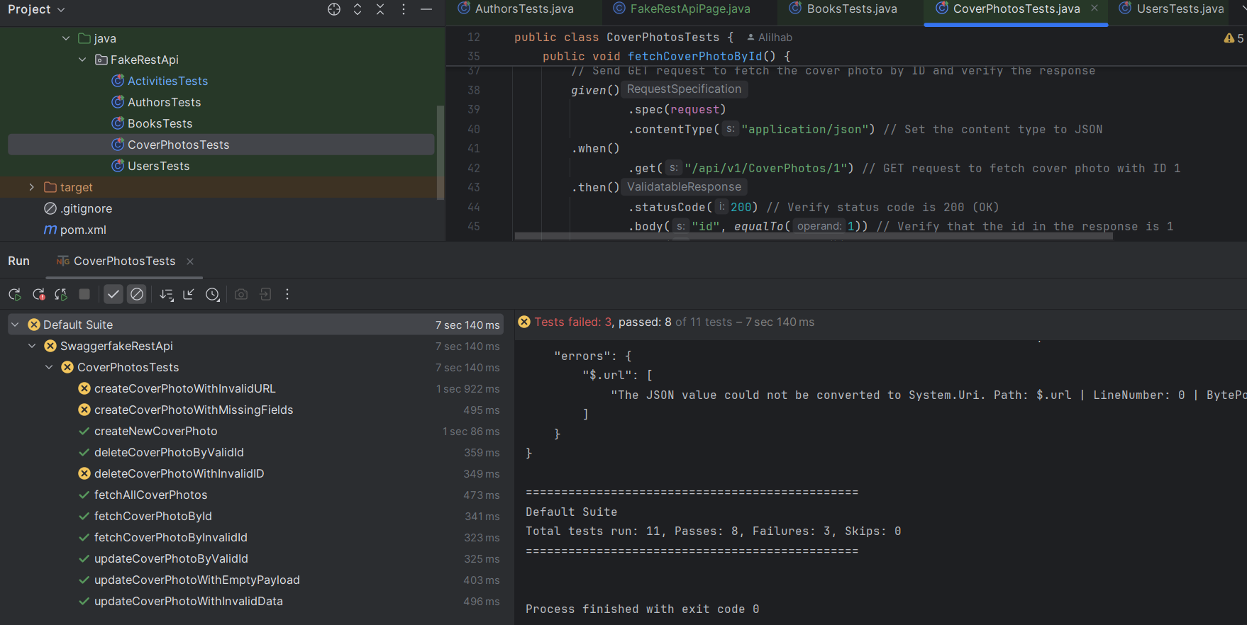
Restassured Testcases executed

Slide 37
Bug Report

Slide 38
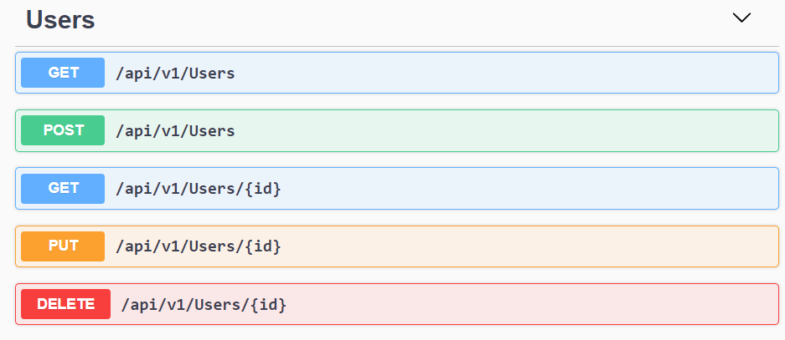
Users

Slide 39
Test Cases

Slide 40
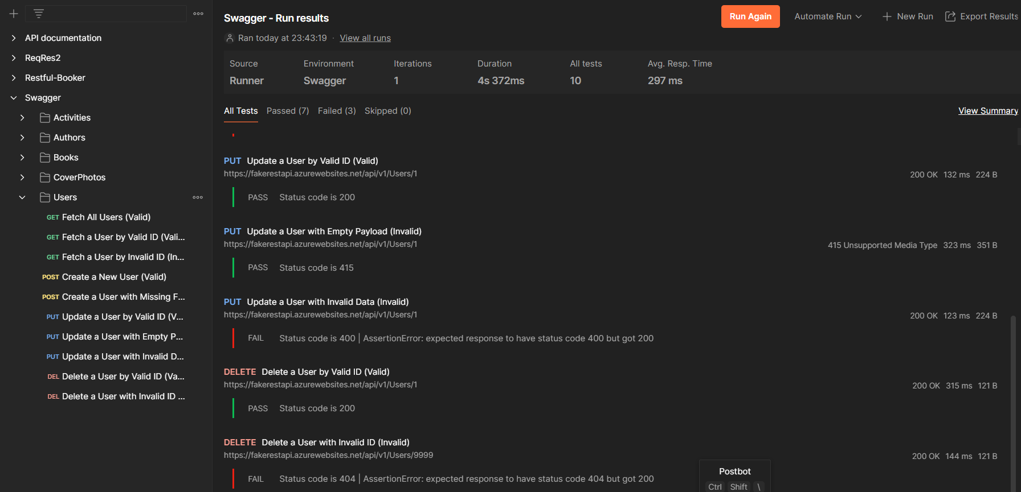
PostMAn Execution

Slide 41
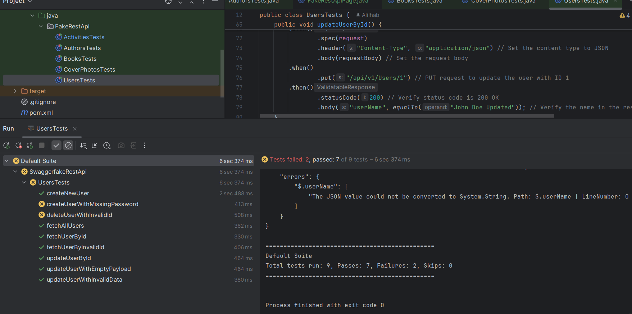
Restassured Testcases executed

Slide 42
Bug Report

Slide 43
Full Project Execution

Slide 44
Project Video

Slide 45
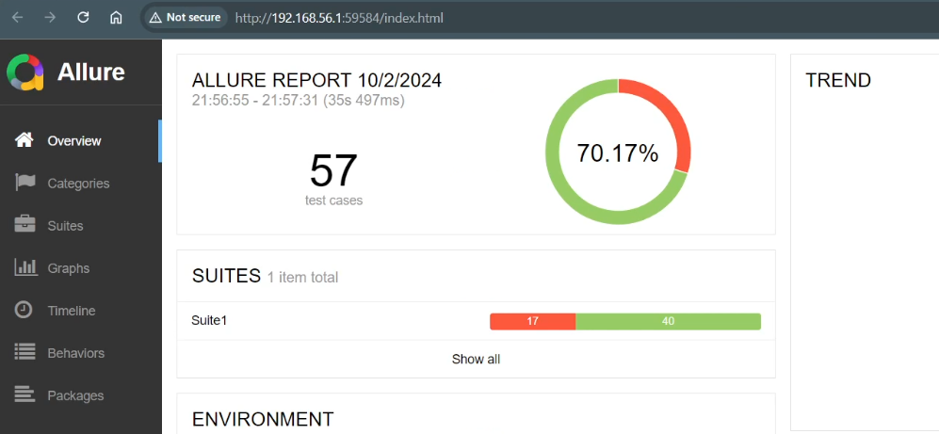
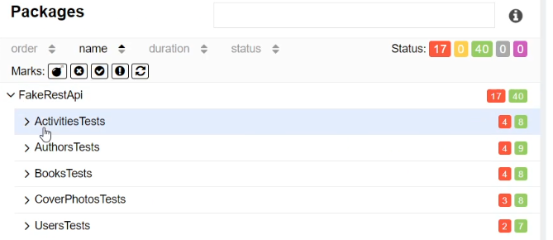
Allure REport

Slide 46
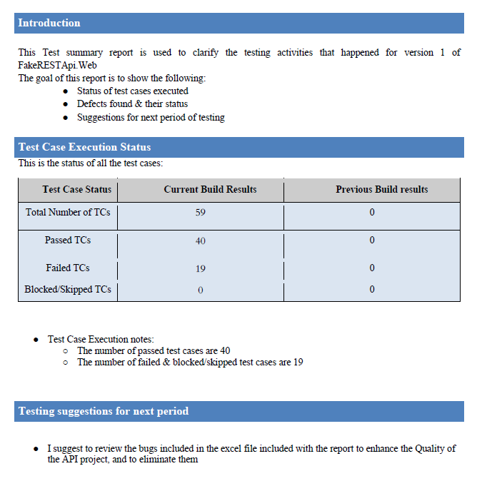
Test Completion Report

Slide 47
Conclusion
Test Cases (Test design)
Postman, Restassured (test implementation & execution)
Bug Report (test execution)
Test completion report (test completion)

Slide 48
Thank you
Any Questions?
Github Of project
https://github.com/AliIhab/FakeRESTApi

